Slide 1
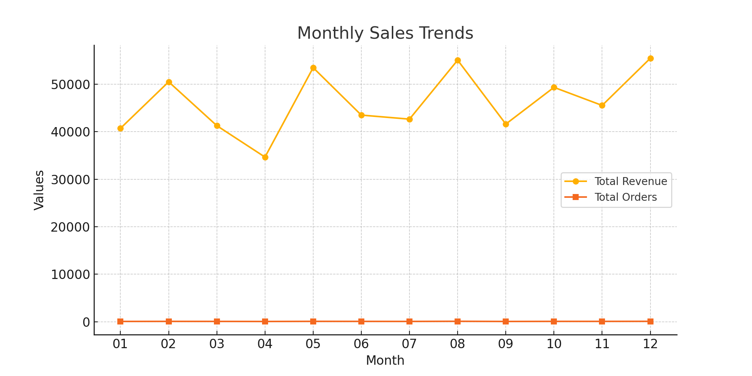
Task 6: Sales Trend Analysis
Monthly Revenue and Order Volume

Slide 2
SQL Script Used
SELECT
strftime('%Y', order_date) AS order_year,
strftime('%m', order_date) AS order_month,
ROUND(SUM(amount), 2) AS total_revenue,
COUNT(DISTINCT order_id) AS total_orders
FROM
online_sales
GROUP BY
order_year, order_month
ORDER BY
order_year, order_month;

